Slide 1
Wisconsinites live, work, and play outside

Slide 2
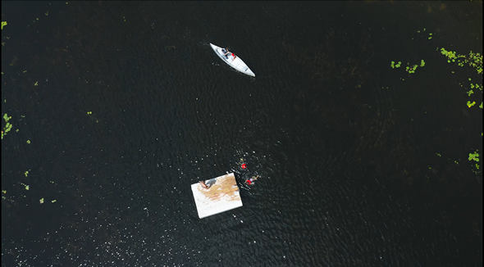
Experience Wisconsin’s outdoor lifestyle
*Click to play video in presentation mode. CRTL + click to play in edit mode.
Notes:
https://youtu.be/bGz16-W3slQ

Slide 3
Wisconsin’s outdoors are remarkable
Nearly half of the state covered by forests
15,000+ inland lakes
43,000 miles of rivers
800 miles of Great Lakes shoreline
2 National Scenic Trails

Slide 4
Paddling
St. Croix National Scenic Riverway
Lake Michigan Water Trail
Lower Wisconsin Riverway
Kickapoo River
NEARBY GEM:

Slide 5
ATV/UTV riding
Wisconsin ATV/UTV Association provides leadership for local clubs
Thousands of miles of off-road trails and on-road routes
NEARBY GEM:

Slide 6
Ice fishing
15,000 frozen lakes make ice fishing accessible
Green Bay of Lake Michigan and tributaries boast big fish
NEARBY GEM:

